Slide 1
FIFA WORLD CUP ANALYSIS
Neeraj V B

Slide 2
INTRODUCTION
Data analysis is a powerful tool for businesses and individuals to gain insights and make informed decisions.
The FIFA World Cup, held every four years since 1930, is the pinnacle of international football, captivating billions of fans worldwide. In this project, I delve into historical data from 1930 to 2014, exploring the general trends that have shaped the world's most prestigious sporting event. By meticulously analyzing vast datasets, I aim to unravel insights on team performance, player statistics, and tournament dynamics that have evolved over the decades. Moreover, I focus on specific teams' performances, scrutinizing their strategies, strengths, and weaknesses to understand how they fared across the tournaments. This comprehensive analysis seeks to shed light on the evolution of the beautiful game, uncovering fascinating patterns and narratives that have left an indelible mark on the history of the FIFA World Cup.

Slide 3
PROBLEM STATEMENT
With FIFA is in the blood of many people of the world. You are tasked to tell the story of unsung analysts who put great efforts to provide accurate data to answer every question of fans. The FIFA World Cup is a global football competition contested by the various football-playing nations of the world. It is contested every four years and is the most prestigious and important trophy in the sport of football. The World Cups dataset shows all information about all the World Cups in history, while the World Cup Matches dataset shows all the results from the matches contested as part of the cups. Find key metrics and factors that influence the World Cup win. Do your own research and come up with your findings.

Slide 4
DETAILS OF DATA
WORLD CUPS
Column name | Description
Year | Year of the world cup
Country | Host Country
Winner | The team that won the world cup
Runners-Up | The team was second place
Third | The team that was third place
Fourth | The team that was fourth place
GoalsScored | Total number of goals scored during the world cup
QualifiedTeams | Total number of teams that qualified for the world cup
MatchesPlayed | Total number of matches played during the world cup
Attendance | Total crowd present during the entirely of the world cup

Slide 5
WORLD CUP MATCHES
Column name | Description | Column name | Description
Year | Year of the world cup | Half-time Home Goals | Goals scored by the home team until half time
Datetime | The Date and time of the match (24H format) | Half-time Away Goals | Goals scored by the away team until half time
Stage | The stage at which the match was played | Referee | Name of the first referee
Stadium | Stadium name where the match was held | Assistant 1 | Name of the first assistant referee (linesman)
City | The city name, where the match was played | Assistant 2 | Name of the second assistant referee (linesman)
Home Team Name | Home team country name | RoundID | Unique ID of the Round
Home Team Goals | Goals scored by the home team in the end | MatchID | Unique ID of the match
Away Team Goals | Goals scored by the away team in the end | Home Team Initials | Home team country's three letter initials
Away Team Name | Away team country name | Away Team Initials | Away team country's three letter initials
Win conditions | Special win condition (if any)

Slide 6
WORLD CUP PLAYERS
Column name | Description
RoundID | Unique ID of the round
MatchID | Unique ID of the match
Team Initials | 3 letter team initials
Coach Name | Name and nationality of the coach
Line-up | S=Starting, N=Substitute
Shirt Number | Shirt number if available
Player Name | Name of the player
Position | C=Captain, GK=Goalkeeper
Event | G=Goal, Y=Yellow Card, R=Red Card, SY = Red Card by second yellow, P=Penalty, MP=Missed Penalty, I = Subbed In, O = Subbed out

Slide 7
MAIN KPIs
Qualifications – Number of times the team qualified for the World Cup
World Cups – Number of World Cups won by the team
Runner-ups – Number of times the team finished second
Third place – Number of times the team finished third
Semifinals – Number of times the team finished fourth
Matches – Total number of matches played by the team
Wins – Total number of matches won by the team
Goals scored – Number of goals scored by the team(excluding penalty shoot-outs)
Avg. Attendance – Average attendance of the games where the team was playing

Slide 8
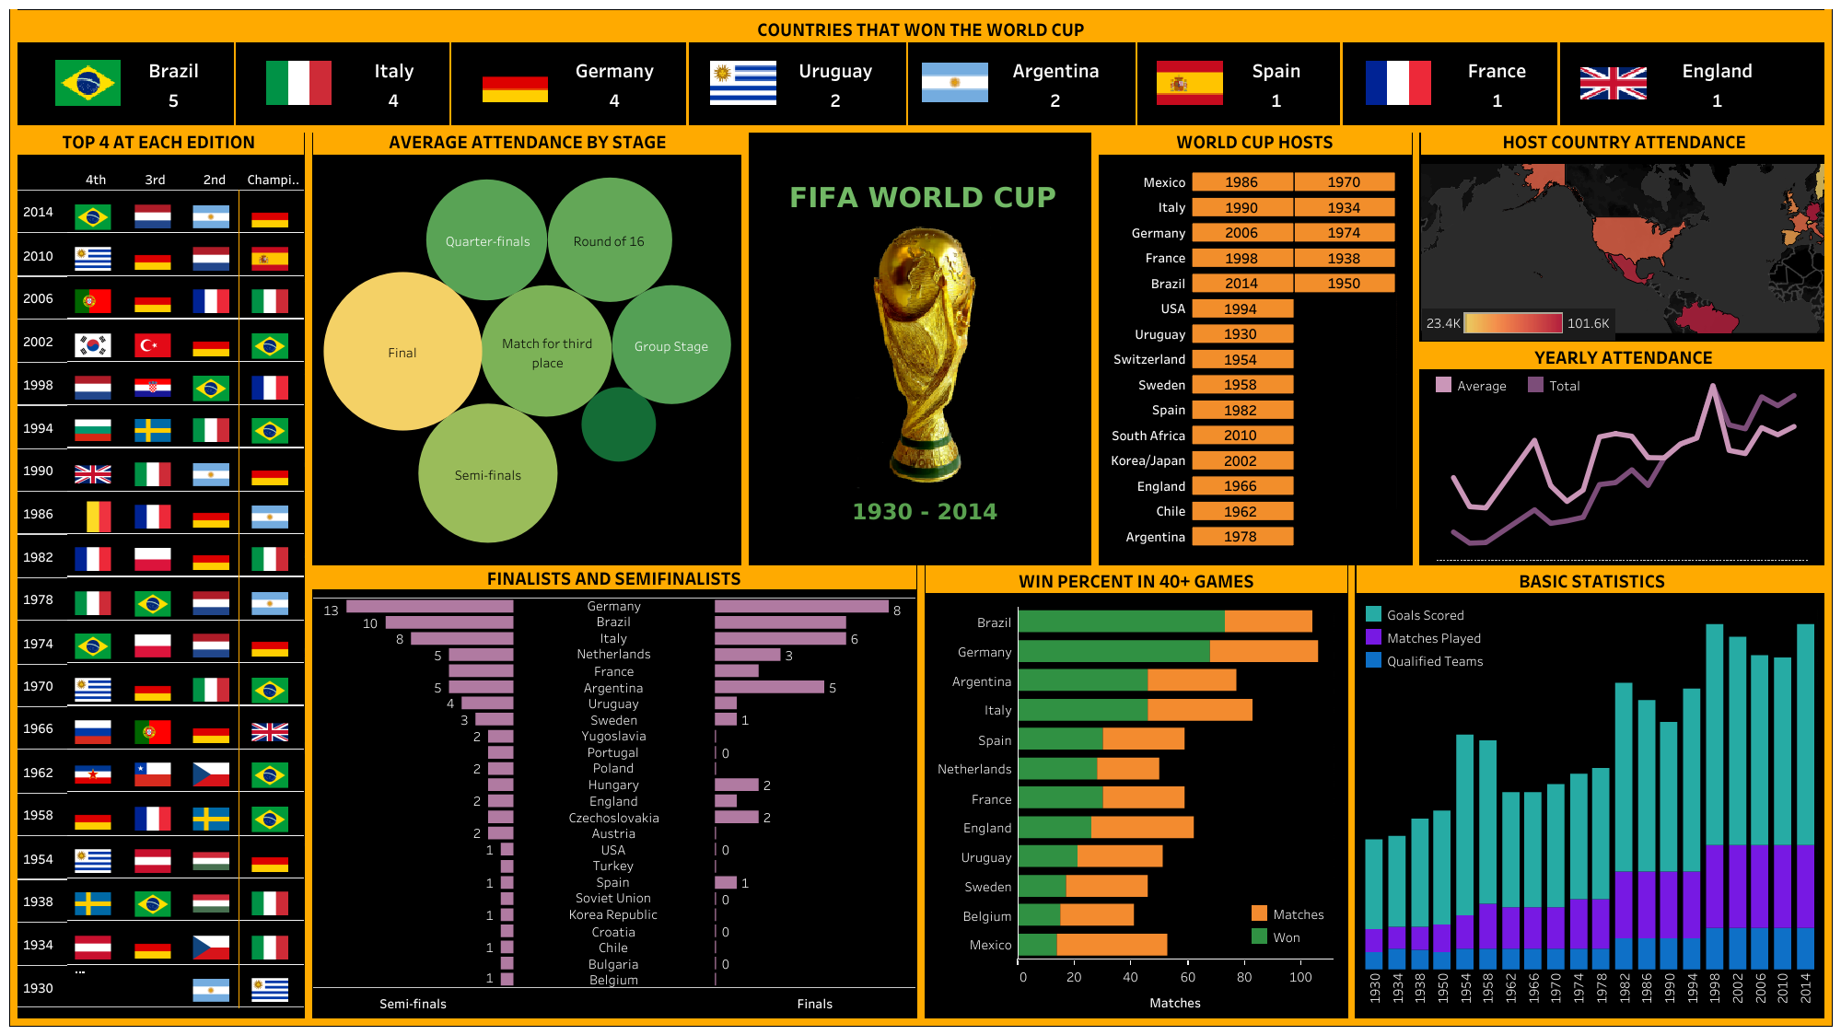
My Design
FINAL TABLEAU STORY DASHBOARDS - link

Slide 9
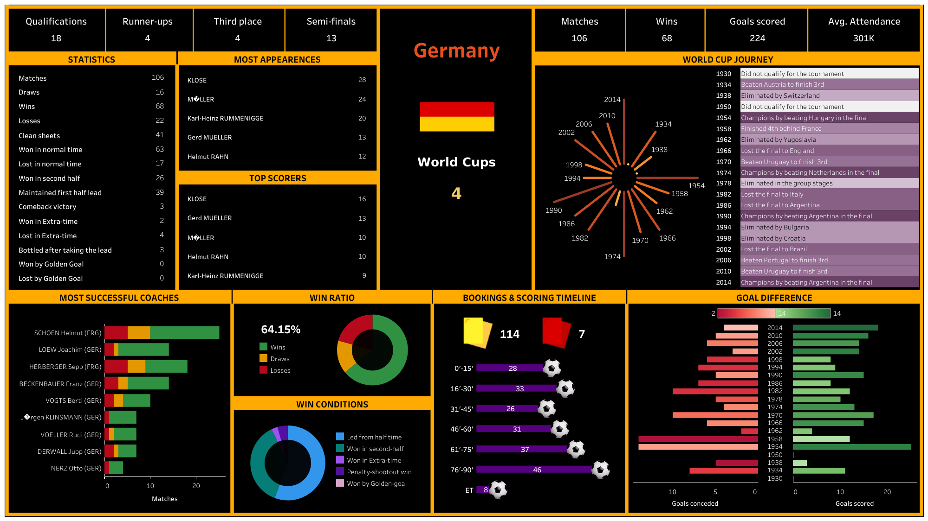
My Design

Slide 10
THANK YOU

